Slide 1

Library Management System
This presentation outlines the key components of a library management system and explains how it can improve library operations.

Slide 2
Overview and Benefits
Centralized System
Improved Efficiency
Enhanced Patron Experience
LMS consolidates all library operations into a single platform.
Automates tasks like cataloging and circulation, saving time and resources.
Provides easy access to library resources and personalized recommendations.

Slide 3
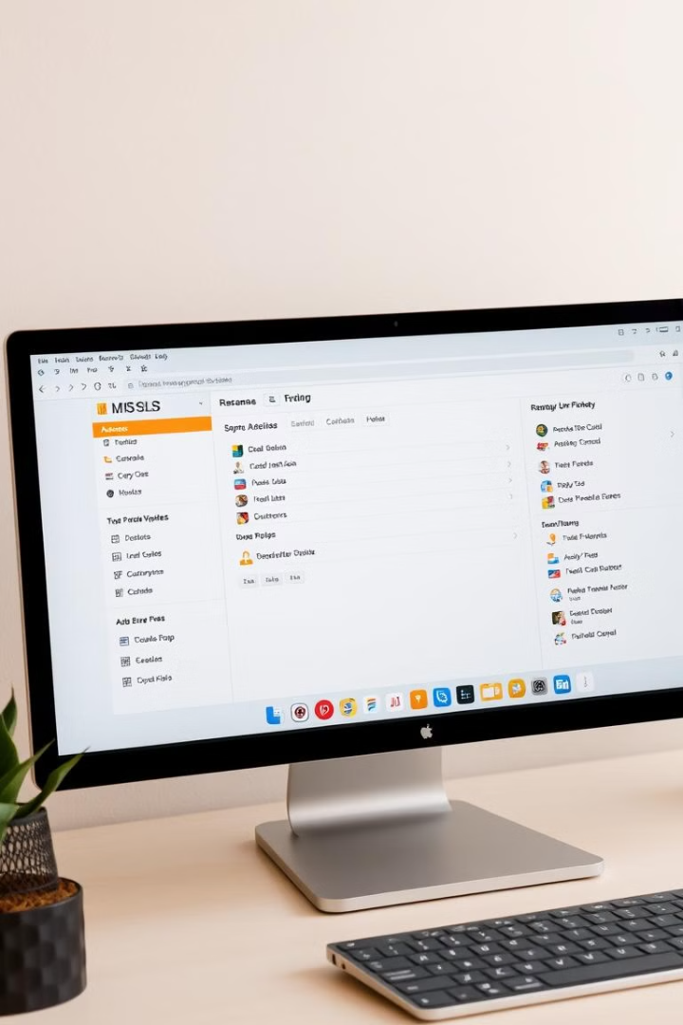
Key Components and Functionalities
Cataloging
Circulation
Manage library collections, including books, journals, and digital resources.
Track loans and returns, manage overdue notices, and generate reports.
Patron Management
Reporting and Analytics
Create patron accounts, manage membership, and track borrowing history.
Generate reports on library usage, collection trends, and patron activity.

Slide 4

Cataloging and Inventory Management
1
Metadata
2
Barcode Integration
Accurate metadata ensures patrons can easily find relevant resources.
Barcode scanning streamlines the process of checking in and out items.
3
Digital Collections
Manage e-books, audiobooks, and other digital resources efficiently.

Slide 5
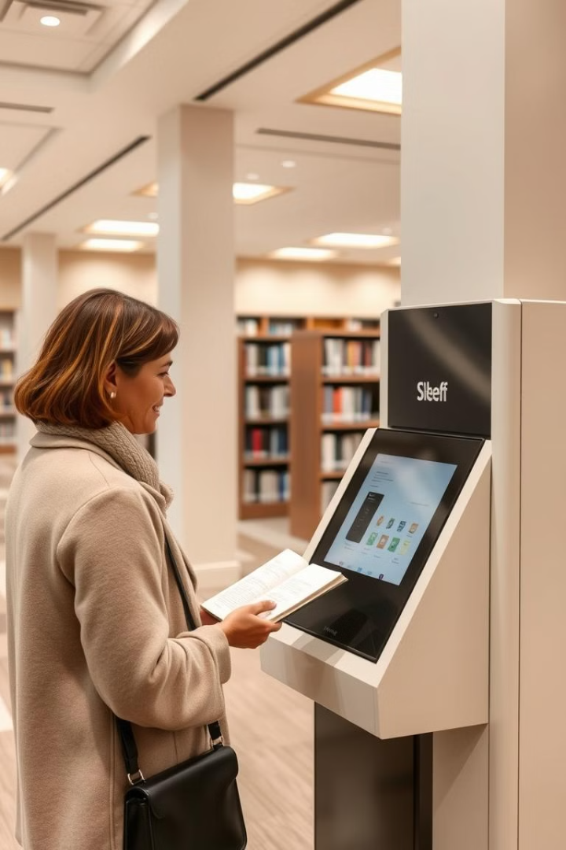



Patron and Circulation Management
Patron Accounts
Due Date Reminders
Create and manage patron accounts, track borrowing history, and enforce borrowing limits.
Send timely reminders to patrons about due dates, reducing late fees and lost materials.
Online Catalog
Allow patrons to search for resources, place holds, and renew materials online.

Slide 6

Reporting and Analytics
1
2
3
Usage Trends
Collection Performance
Patron Demographics
Track borrowing patterns, identify popular resources, and measure library impact.
Analyze circulation data to identify underutilized materials and make informed decisions about acquisitions.
Understand patron demographics to tailor services and outreach efforts.

Slide 7
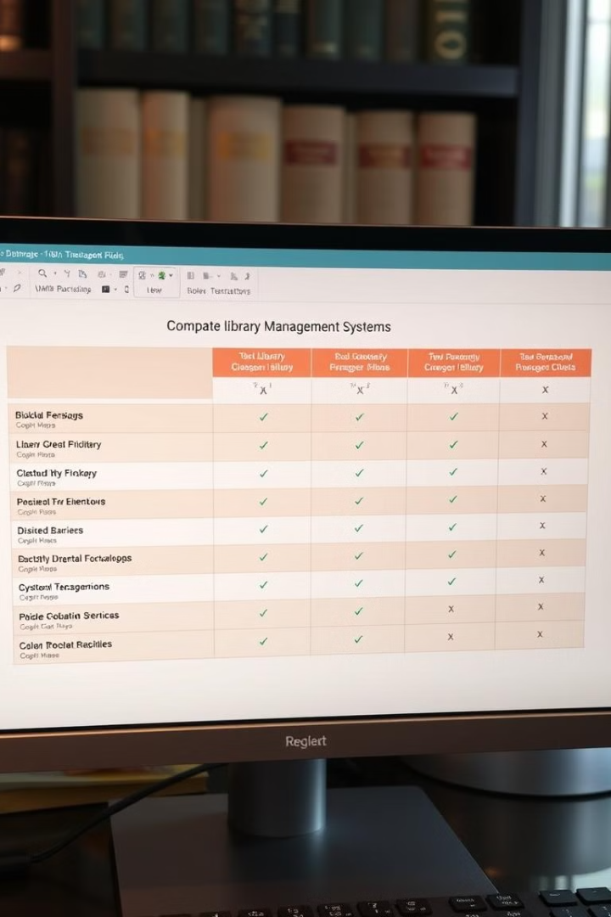



Choosing the Right LMS
Library Needs
Determine specific requirements based on collection size, patron base, and budget.
Vendor Research
Compare features, pricing, and customer support of different LMS vendors.
Pilot Program
Implement a trial version of the chosen LMS to test its functionality and usability.

Slide 8



Implementation and Adoption Strategies
Training
1
Provide comprehensive training to staff on the new LMS.
Communication
2
Inform patrons about the new system and how it will benefit them.
Support
3
Offer ongoing technical support to staff and patrons.

Slide 9

Conclusion and Next Steps
A library management system can streamline operations, improve patron experiences, and enhance the overall efficiency of a library. The next step is to choose an LMS that meets your specific needs and implement it effectively.

